Slide 1
Where Can I Find?
Al and Max

Slide 2
Overview - features
Where can I find?
Sites near me
Submit a report
The logs
Notes:
Where can I find finds the best place to find a particular species, sites near me shows where local wildlife hotspots are, the logs contains many user reports for others to read, which can be submitted from the site

Slide 3
Where can I find?
Give it a species and postcode
Returns good sites to find that species
Perhaps could give directions
Suggestions powered by user reports

Slide 4
Sites near me
Uses Google maps to show particular
spotting hotspots
- Again powered by user reports

Slide 5
Logs and reports
Users can upload reports, containing species, locations, pictures etc.
This data powers rest of sites features
Logs allow users to search data

Slide 6
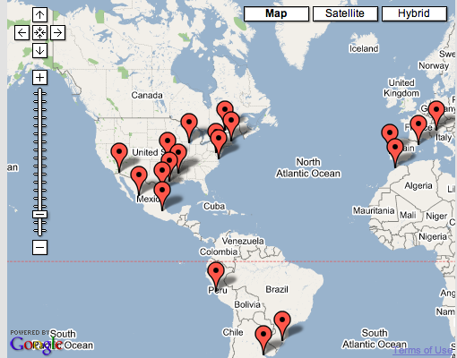
What we’ve done today
Imported the Google maps API and put it on a website

Slide 7
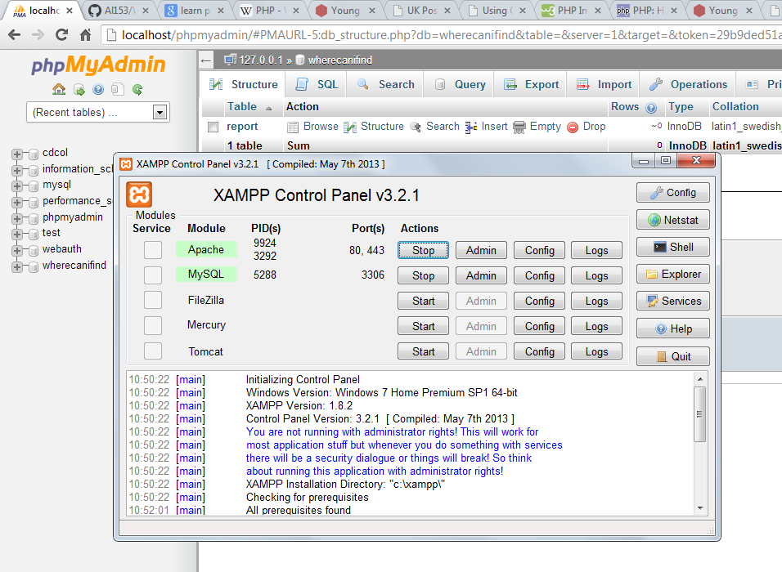
What we’ve done today
Set up Apache web server and started work on a user report database

Slide 8
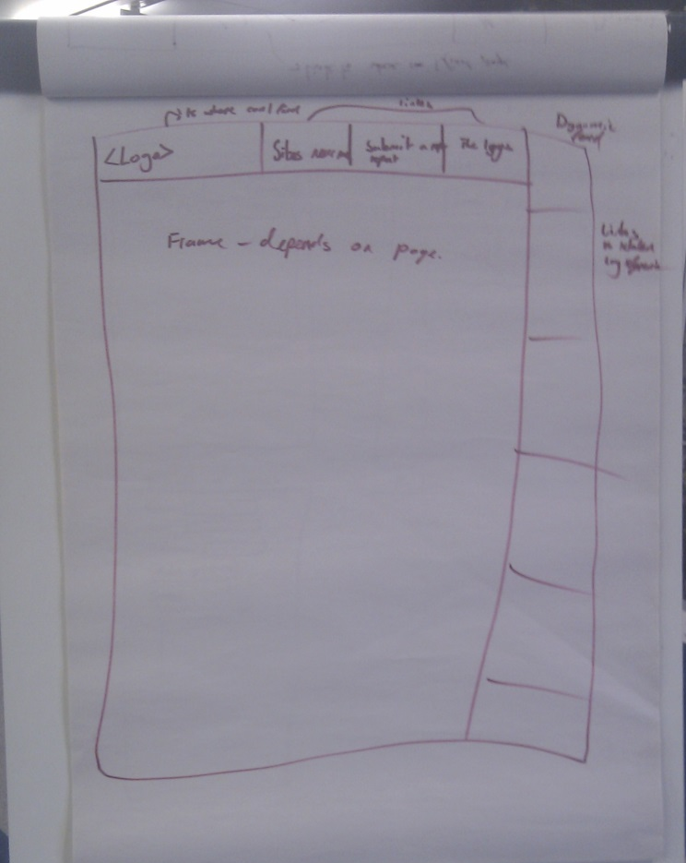
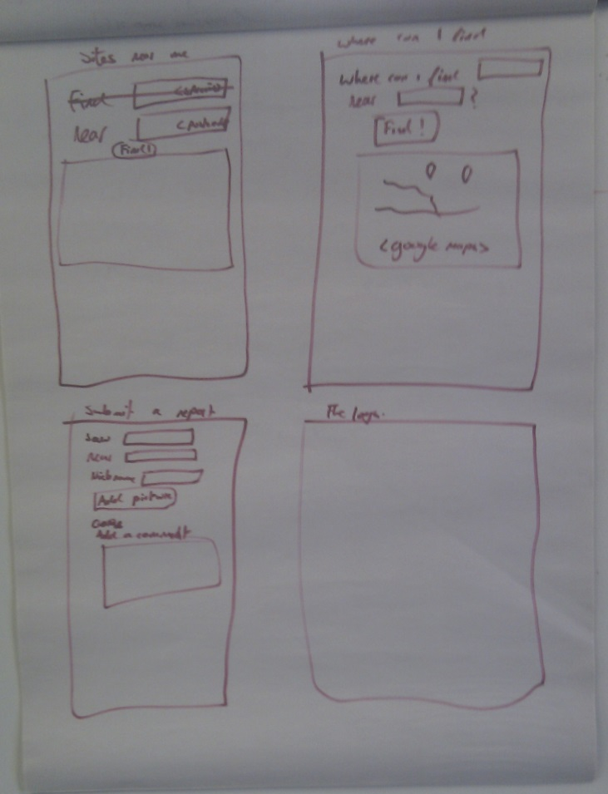
What we’ve done today
Created an overall design for the website with multiple features

Slide 9
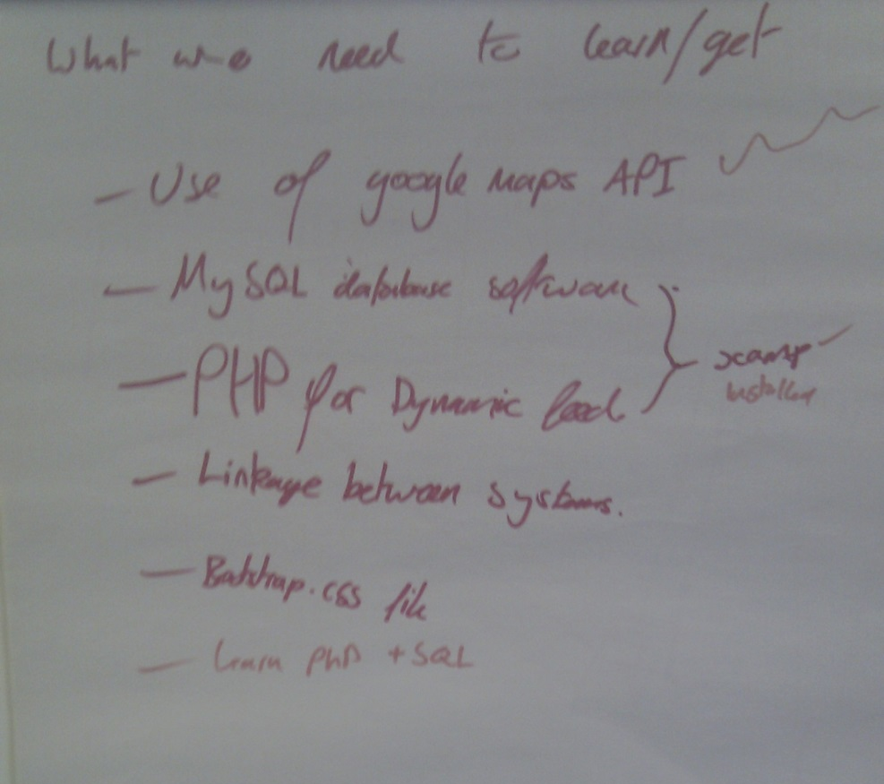
What we’ve done today
Worked out what we don’t know

Slide 10

To do…
Get to grips with SQL and PHP
Help welcome!

Slide 11
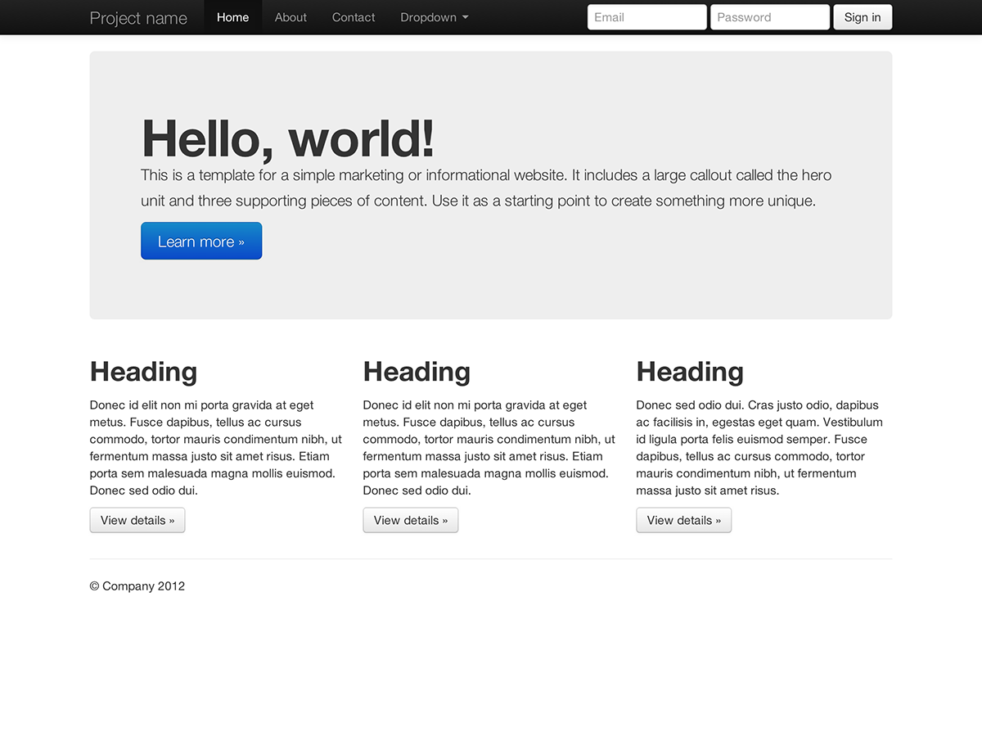
To do…
- Implement website design in HTML and CSS, perhaps
using bootstrap

Slide 12
To do…
Add sample user reports so we have something to show

